Slide 1
Swypin Research Project
Aditi Phatak

Slide 2
Summary
User study 1 compared 3 different designs for the dial and found design 3 to be the most optimal with much lower error rate and fastest password recognition time.
User study 2 aimed to add a weighted gesture recognition algorithm.
The main challenged faced were:
  Making the gesture algorithm correctly recognize gestures
  Fine tuning prediction score for accepting a gesture as correctly recognized since the general rule of 1.0 score was too liberal.
  Disregarding correct gestures but in a different orientation.
Result: The gesture recognition worked great but not fast enough. Optimizing the recognition went into the realms of making the recognition algorithm itself more efficient. It was no longer suitable for phone unlock since adding the gesture recognition dramatically reduced the access time making the entire design deficient.

Slide 3
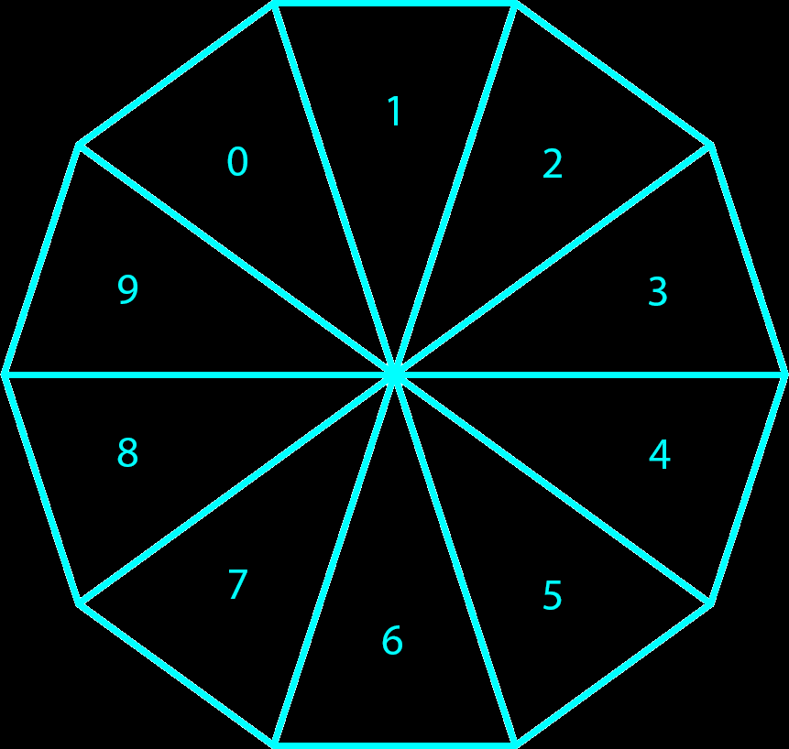
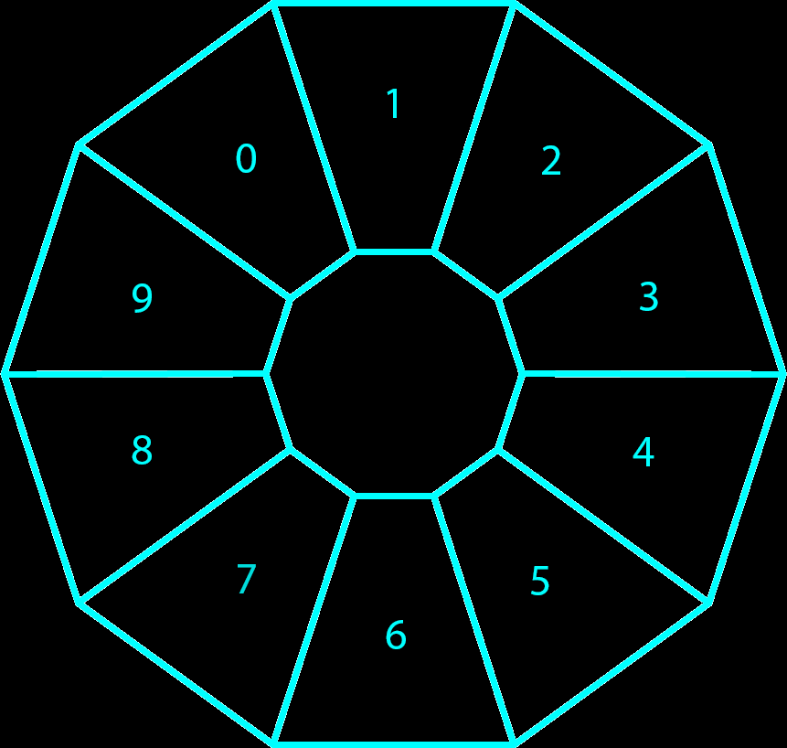
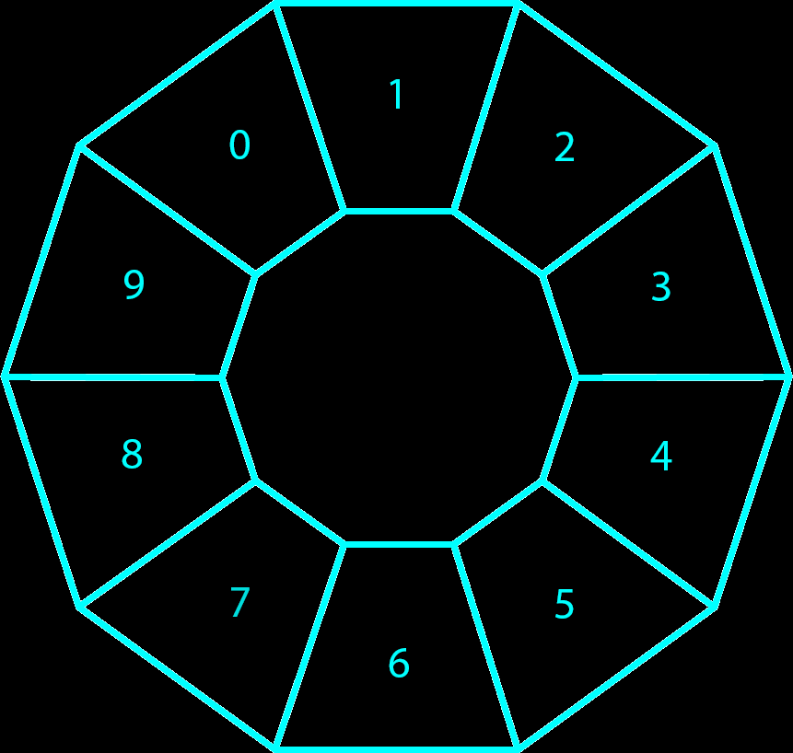
The Three Designs
Design 1
Design 2
Design 3

Slide 4
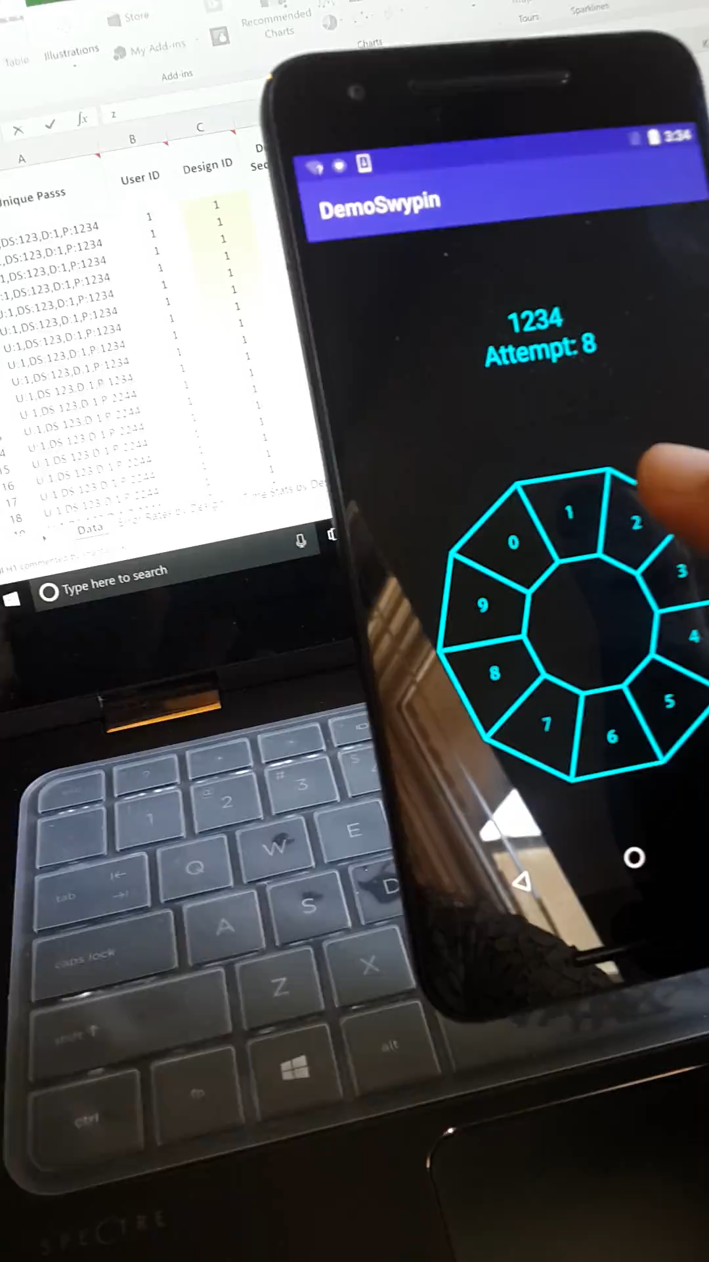
User Study 1: No gesture/Only discrete PIN recognition:
Video

Slide 5
Results of Study1: Error Rate
Design/Password Filter | Error Rate
Design 1 (mean) | 0.21954023
1234 | 0.048275862
2244 | 0.28
6348 | 0.332142857
Design 2 (mean) | 0.195505618
1234 | 0.07
2244 | 0.293333333
6348 | 0.224137931
Design 3 (mean) | 0.133333333
1234 | 0.066666667
2244 | 0.183333333
6348 | 0.15

Slide 6
Results of Study1: Recognition Time (in ms)
Row Labels | Average of Time (ms) | StdDev of Time (ms) | Max of Time (ms) | Min of Time (ms)
Design 1 –Mean | 1421.08 | 917.32 | 7300 | 236
1234 | 444.34 | 177.74 | 2656 | 236
2244 | 1756.12 | 640.11 | 7300 | 447
6348 | 2073.75 | 780.56 | 6089 | 623
Design 2 –Mean | 1072.27 | 645.92 | 4677 | 153
1234 | 427.04 | 143.84 | 1550 | 153
2244 | 1585.62 | 536.83 | 4677 | 345
6348 | 1208.69 | 489.29 | 3947 | 592
Design 3 -Mean | 1064.80 | 662.97 | 5188 | 210
1234 | 451.03 | 205.72 | 2268 | 210
2244 | 1600.65 | 609.36 | 5188 | 318
6348 | 1142.73 | 485.53 | 3907 | 581

Slide 7
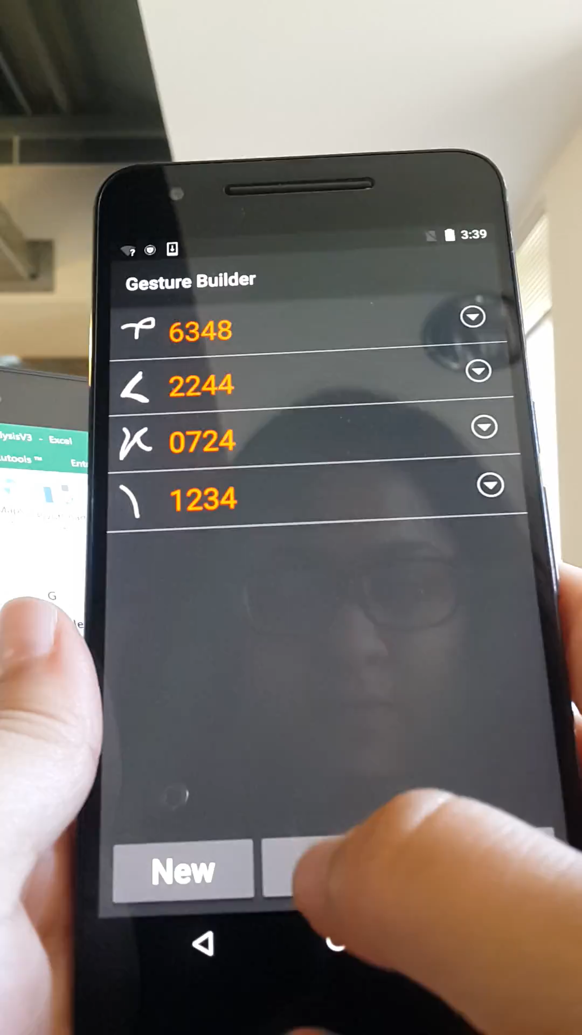
Gesture recognition only/No Discrete PIN Recognition:
Video

